Slide 1


micro:bit entry video tutorial
Lesson 16
micro:bit lesson 16 “Look how far you are from me”
YahBoom micro:bit module tutorial

Slide 2
micro:bit entry video tutorial
Content
Part1
Part 2
Part3
Part 4
Part 5
Learning goals
Preparation
Connection
Search for blocks
Combine blocks
YahBoom micro:bit module tutorial

Slide 3
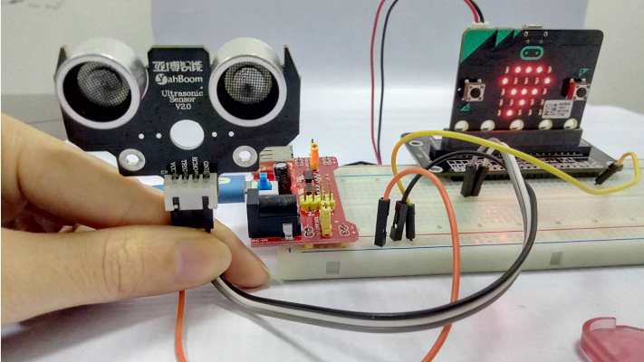
micro:bit entry video tutorial
Part 1
Learning goals
Children can use a ultrasonic module and a micro:bit to make a distance detector to see how far you are from me.The jumper wire cap of the power supply module connects 5V to OFF to output 5V voltage.
YahBoom micro:bit module tutorial

Slide 4
micro:bit entry video tutorial
Part 2
Hardware:
● 1 X Micro: bit Board
● 1 X Micro USB Cable
● 1 X Micro:bit breakout
● 1 X Male to male cable
● 4 X Female to male cable
● 1 X 830 holes breadboard
● 1 X Ultrasonic sensor
Preparation
Then the micro:bit is connected to the computer through USB, and the computer will pop up a U disk and click the URL in the U disk to enter the programming interface. Input this URL https://github.com/lzty634158/yahboom_mbit_en to get the package.
YahBoom micro:bit module tutorial

Slide 5
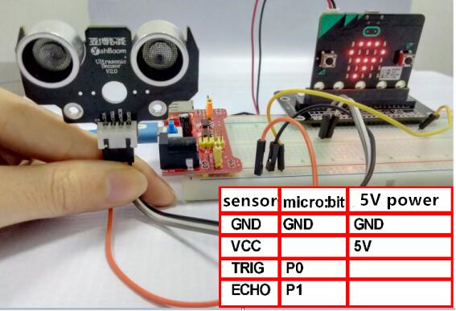
micro:bit entry video tutorial
Part 2
Connection
Connection line according to the upper drawing.
Note: Ultrasonic sensor must work at 5V, and micro:bit GND must be connected to GND of ultrasonic sensor.
YahBoom micro:bit module tutorial

Slide 6
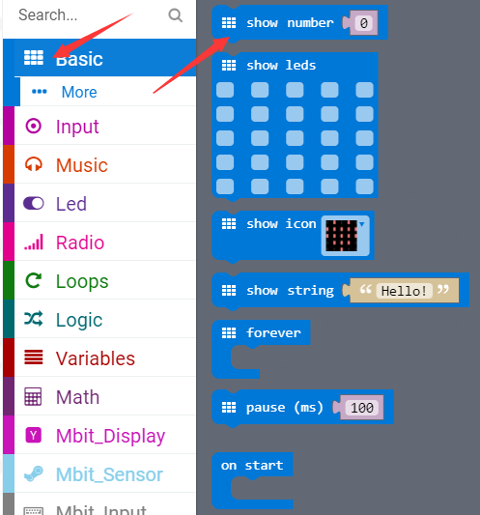
micro:bit entry video tutorial
Part 3
Search for blocks
YahBoom micro:bit module tutorial

Slide 7
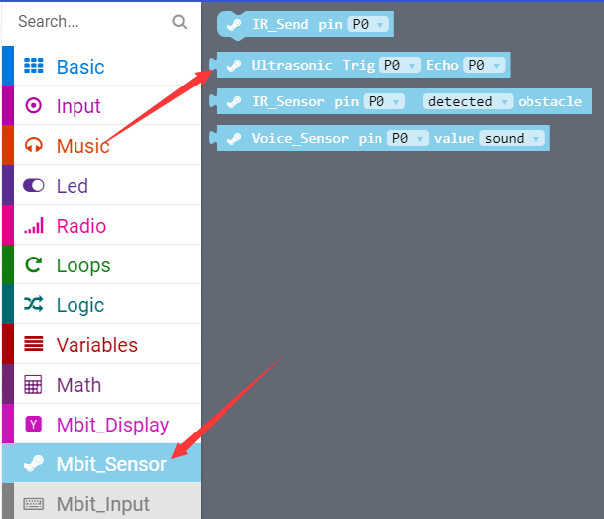
micro:bit entry video tutorial
Part 3
Search for blocks
YahBoom micro:bit module tutorial

Slide 8
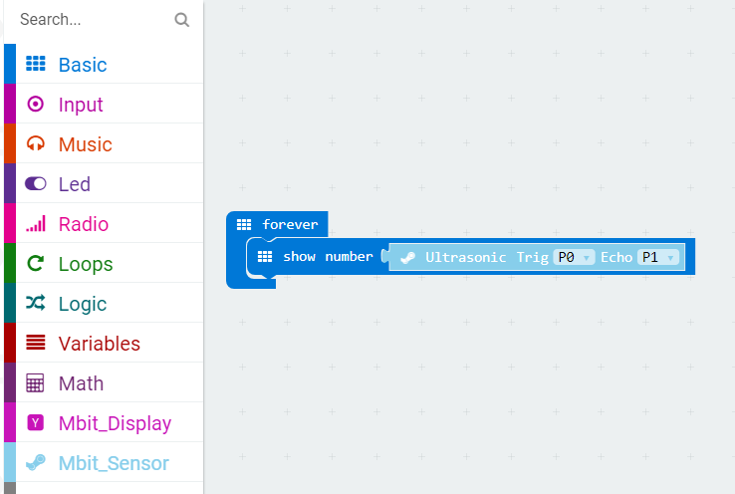
micro:bit entry video tutorial
Part 4
Combine blocks
YahBoom micro:bit module tutorial

Slide 9
micro:bit entry video tutorial
micro:bit
project
Thanks for watching！
Powered by YahBoom
YahBoom micro:bit module tutorial

